Slide 1
Project and Financial Management Guidance
Tracking UNDP COVID-19 Response
Version 1.0
3 April 2020

Slide 2
Business flow model
Ready!
Submit request for allocation
STARS
Secure financial resources
Create new outputs
ATLAS
Mark new outputs
COVID-19 Marker
Implement and Monitor
COVID-19 Monitoring Dashboard
Report and Learn Lessons
COVID-19 Reporting Platform
Coming soon!
Ready!
Coming soon!
Ready!
Ready!
Notes:
Hanayo

Slide 3
Requests for RRF Country Allocation (STARS)
Submission for all types of COVID-19 support
Category for Covid-19 Rapid Response Facility (RRF) Country Allocation
All requests managed in STARS
Consultations for decision take place offline
Data available in STARS Power BI Analytics
Plan to add field for amount approved and project ID to link to the allocation
Notes:
Patrick

Slide 4
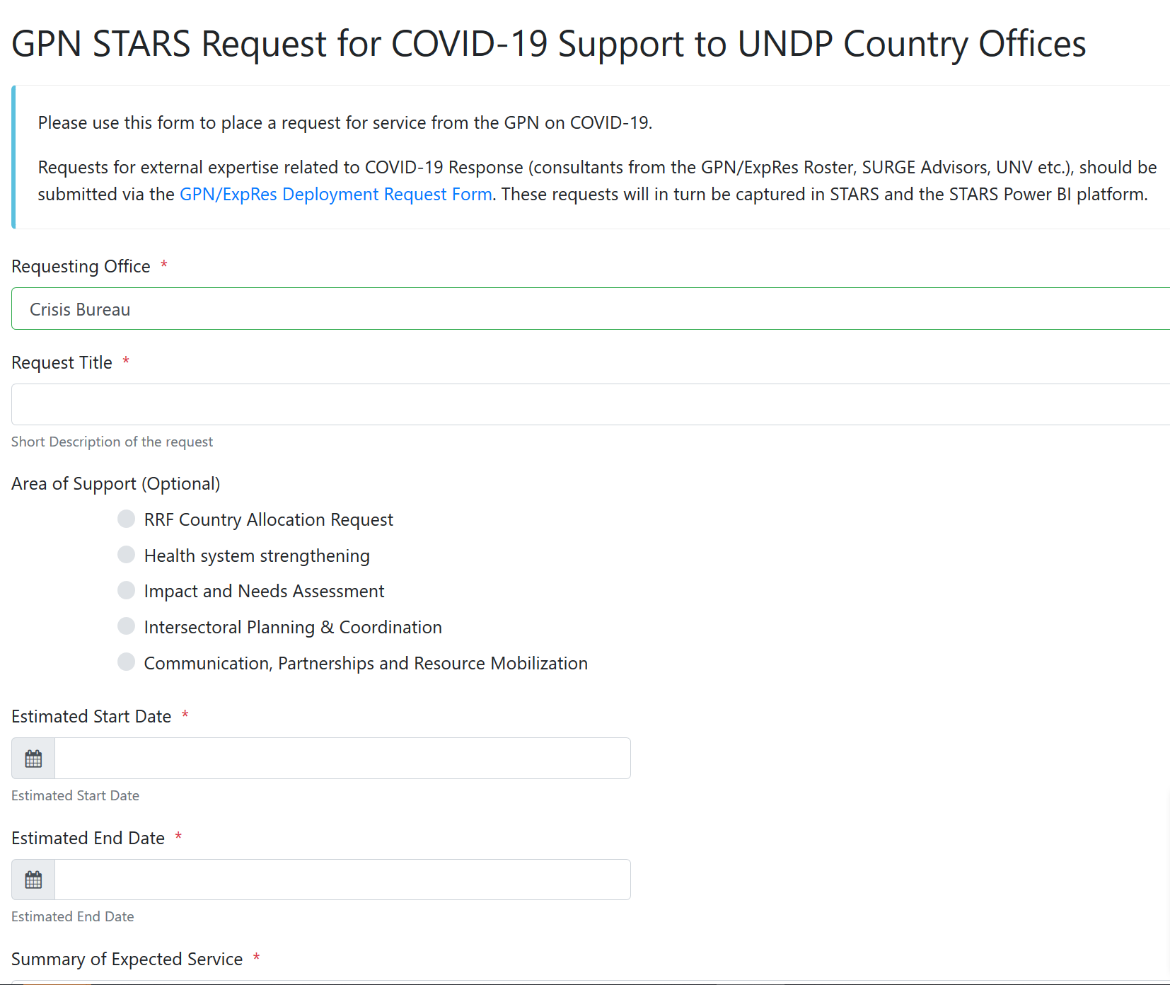
Requests for RRF Country Allocation (STARS)
Submission for all types of COVID-19 support
Category for RRF Country Allocation
All requests managed in STARS
Consultations for decision take place offline
Notes:
Patrick

Slide 5
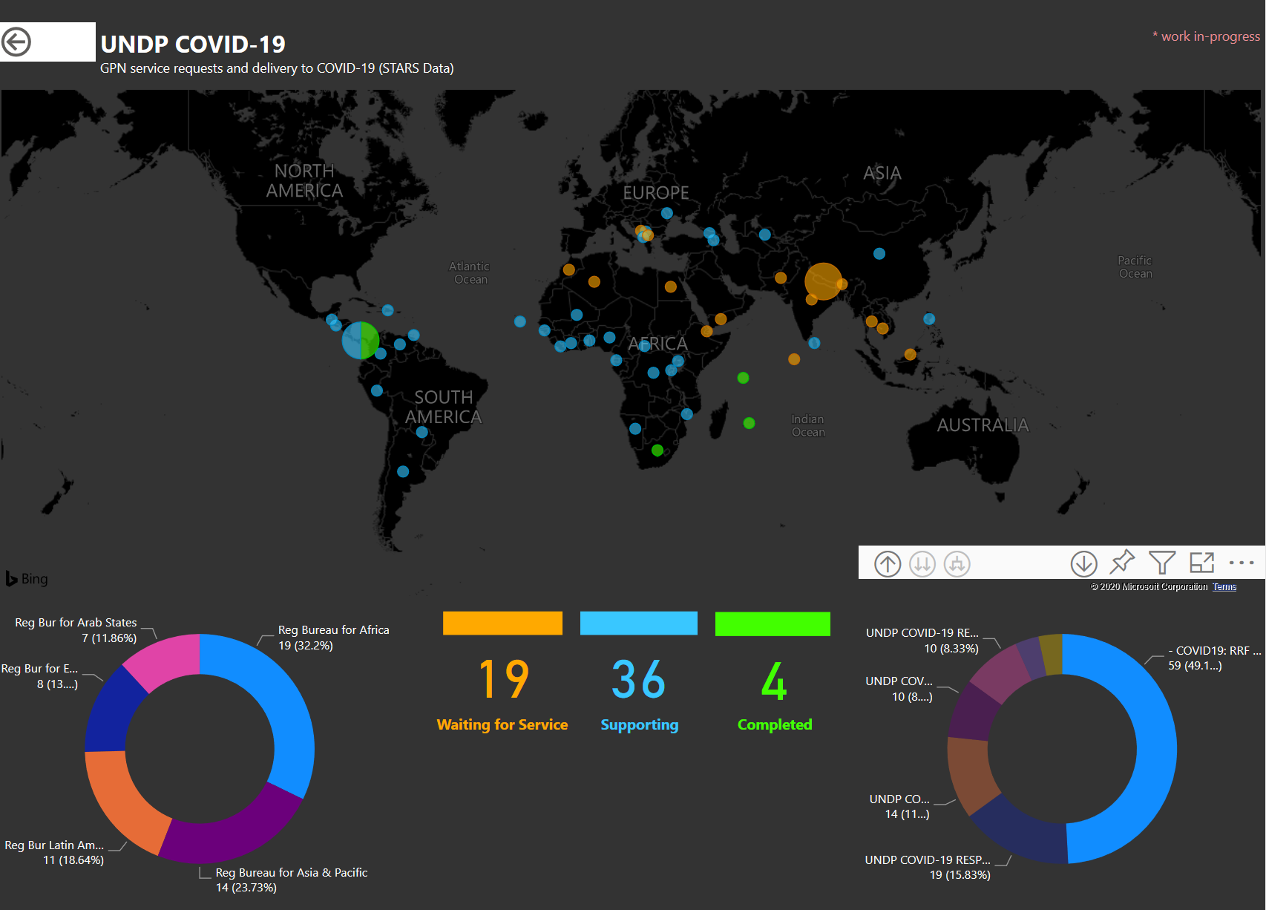
STARS Data Analytics
COVID-19 Requests available in STARS PowerBI Analytics, including RRF Allocation and direct support
NEXT STEPS
Power BI improvements (export function, additional filtering etc.)
Plan to add field for amount approved and project ID to link to the allocation
Notes:
Patrick

Slide 6
Moving Resources
UNDP INTERNAL RESOURCES
TRAC RESOURCES
11888
($20M)
Reserves?? (impact funds)
NON TRAC RESOURCES
TRAC1: already allocated
Global/Regional PROG.: (BPPS/RB)
TRAC3: (CB)
TRAC2: (RBX)
UNDP NON-CORE RESOURCES
Repurposing Unspent balance
-$4.3bn /Aging
- Donor negotiation
- Project closure
New Donor Funding
- RM
- Private sector
- Individual donors
VTF
-Negotiation with BPPS
Fund managers
Non GMS but DPC
DPC
Notes:
Amat

Slide 7
UNDP Funding Windows dedicated COVID-19 Fund Codes in Atlas:
FW1
GLOBAL WINDOW
FUND 28641
ASL
FW2
REGIONAL WINDOW
FUND: 28643
CASH
FW3
CO WINDOW
FUND:28644
CASH
CORE RESOURCES
TRAC1,2,3,RP,GP
FW1
GLOBAL WINDOW
FUND 28642
CASH
Notes:
Amat

Slide 8
undp Covid-19 Response: Corporate systems
Application | Digital Platform | Atlas | IRRF Linking Platform
Team | IMT, BPPS and Crisis Bureau | OFRM, IMT | IMT, BPPS and Crisis Bureau
New Components | COVID-19 monitoring platform to track resources available, allocated and spent, as well as results and challenges on COVID-19 (UNDER DEVELOPMENT) | New set of fund codes created under the UNDP Funding Windows, specific to COVID-19
Changes to existing corporate applications | STARS platform upgraded to include requests for services related to the three UNDP COVID-19 programmatic offers |  | New COVID-19 Project Marker created
Guiding Design Principles
Align the Data Structures to enable next steps from proposal to project execution.
COVID-19 monitoring platform being developed
Monitoring
Lessons Learning and Reporting
Analytics
Notes:
Yazan

Slide 9
Atlas anD Marker Guidance
COs create a new Output under existing Project or new Project. Provide clear titles and descriptions of projects, outputs and activities that are understandable by public (e.g. avoid acronyms). Ensure “COVID-19” is included in project and/or output titles.
Communicate the Output ID to FundingWindows@undp.org for the allocation to be issued.
COs enter the project budget using the fund, donor codes and GMS rate provided in their allocation letter, and ensure the project has been approved, the output is active and the budget is kk’d.
24 hours after a new Output is created, COs tag the output to the COVID-19 Marker through the IRRF Linking Platform.
Notes:
Yazan

Slide 10
Atlas Projects
Atlas Projects will be utilized similar to the regular projects in Atlas.
Budgets to be entered, managed as per the existing practice. Approved project budget will be required in order to be able to utilize the project.
Project Risks to be entered in atlas.
upload any relevant documents as per the existing practice.
UNDP Project Management Guide
Notes:
Yazan

Slide 11
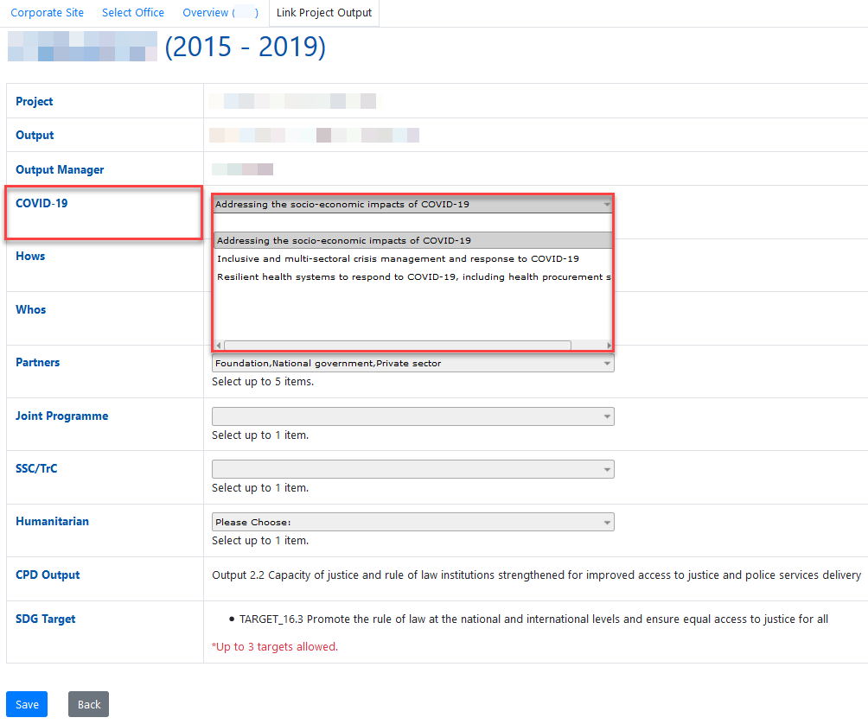
MARK the Output
24 hours after a new Output is created, tag the Output with COVID-19 Marker.
https://intranet-apps.undp.org/UNDP.HQ.CPS2018/app/offices
1. Select the respective office.
2. Click on Step3 link
3. Click on “Project Output Linking”
4. Click on the Output ID
5. Tag the output with COVID-19 Marker. Select one from the three types of interventions.
- Addressing socio-economic impacts
- Inclusive and multi-sectoral crisis management and response
- Resilient health systems
6. Make sure other project markers are properly selected – LNOB, Partners Marker, SSC Marker, etc.
7. Click on “Save”
Notes:
Hanayo

Slide 12
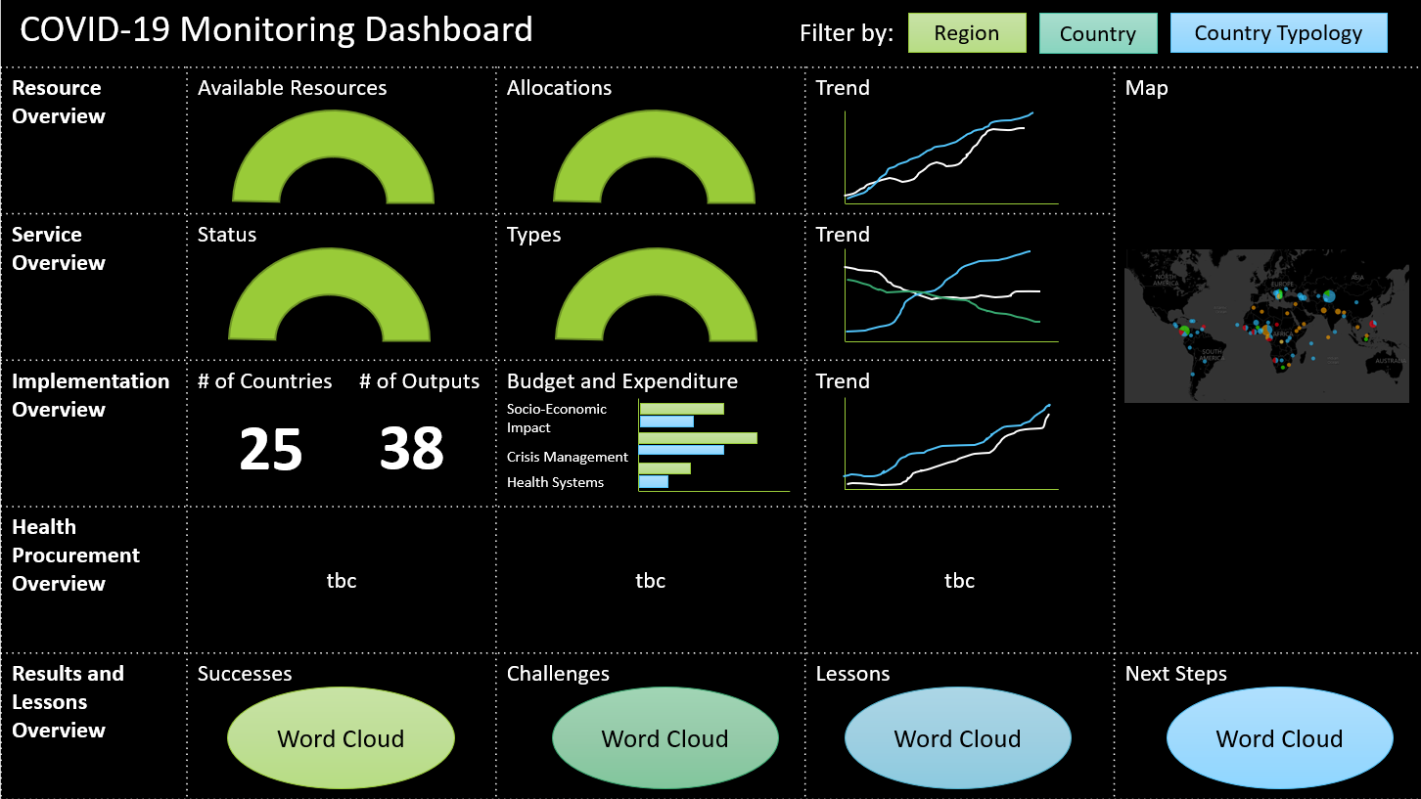
COVID-19 Monitoring dashboard
Coming soon!
SAMPLE
Notes:
Hanayo

Slide 13
COVID-19 reporting platform
Coming soon!
Simple format for progress and results analysis and reporting (1 para each)
Successes
Challenges
Lessons
Next Steps
AI (Machine Learning) will be applied to analyze reported contents
Notes:
Hanayo

Slide 14
For questions, write to [Atlas] ps.support@undp.org [funding windows] FundingWindows@undp.org [covid-19 marker / monitoring dashboard] RESULTs@undp.org

Slide 15
Detailed slides
Notes:
Hanayo

Slide 16
Refresher Atlas Workflow for Creating New Project:
Approve Proposal
Send to KK and Finalize
No
Yes
Yes
Generate Award
Project
Revise or Withdraw
Submit Proposal
Project is Active “Ongoing”
No
Once this is done, the Allocation can be assigned and expenditures can be incurred.
Post Award/Project:
Budget
COA
Activities
Targets/Results
Create Project Proposal

Slide 17
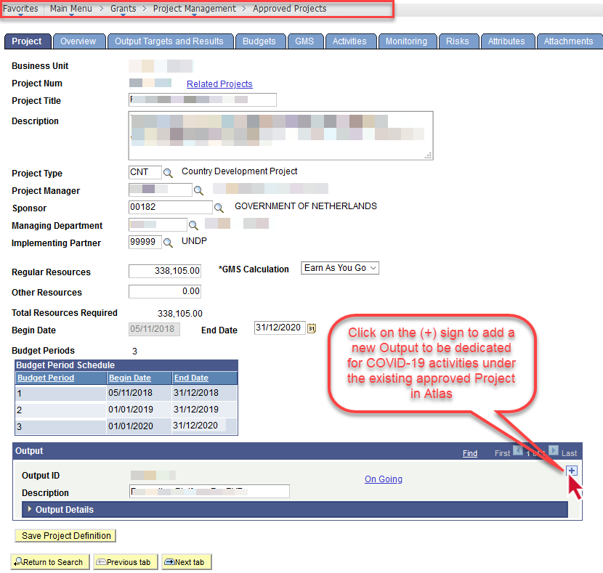
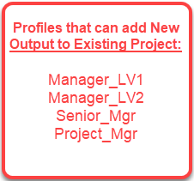
Create new output under existing Project
To create a new output in Atlas under an existing project, follow the navigation below:
Grants > Project Management > Approved Projects
Click on the (+) sign to add a new output and then fill the output information (description, short description, start/end date etc.)
Then you will need to enter the Activity ID and activity description then click on

Slide 18
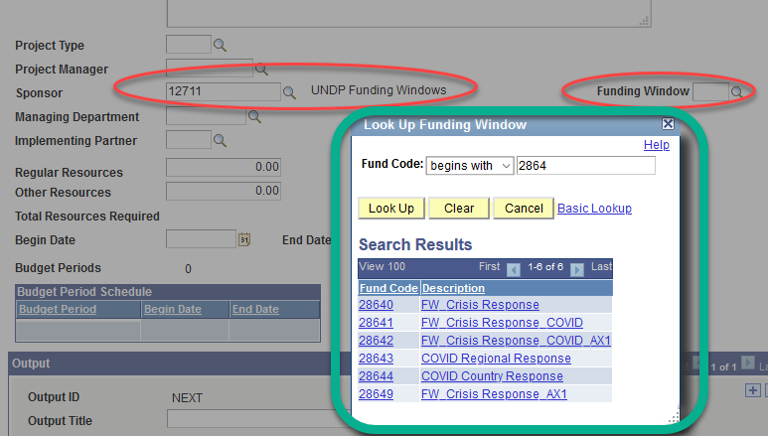
The Project Budget (Funding Window)
Please ensure to use the Funding Window fund code provided in the allocation letter.
A GMS rate of 7% “earn as-you-go” will likely apply (mentioned in the allocation letter).
Ensure the project is approved (if new), the output is active and the budget is kk’d.

Slide 19
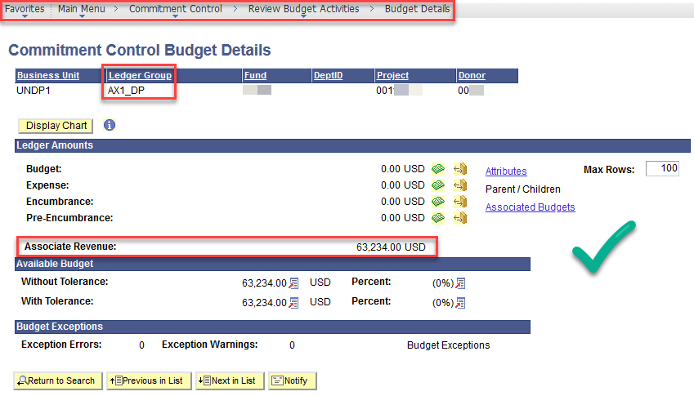
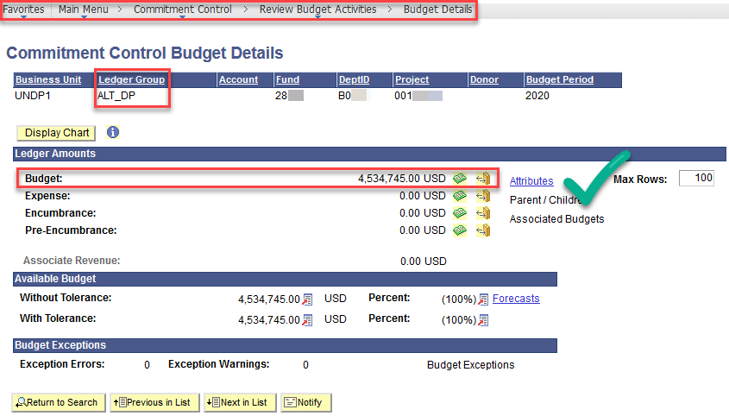
Validate Cash And Allocation
Validate and make sure that for Cash Ledger (AX1) the cash is reflected and for Allocation Ledger (ALT) the allocation is reflected.
For Cash Ledger (AX1), it will be established once or twice a week by GSSC after the project budget was approved/finalized. (PAR_DP)

